Slide 1

Predictive Modelling Results
Report By
Data Science Team

Slide 2
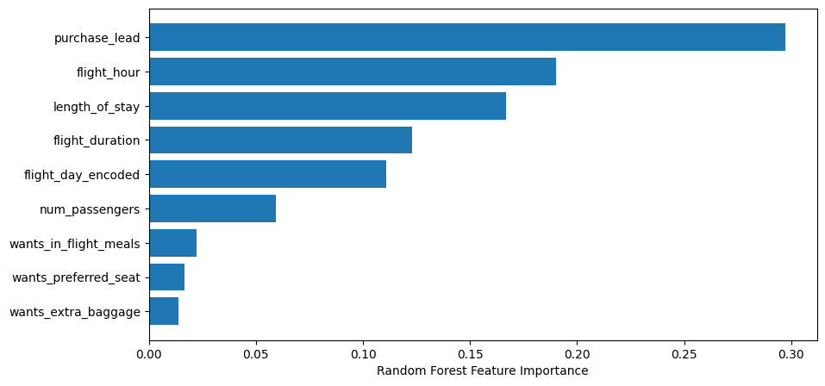
Predictive Modelling Results
F1 Score
77%
Accuracy
94%
Precision
100%
Top features that can drive successful flight bookings.

